Slide 1
P R E D E S T I N A T I O N
Designed by: Hayworth Anderson, Jacob Brink, Advait Scaria, Ethan Walters, and Nathan Wang

Slide 2
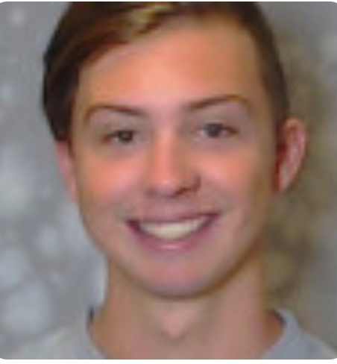
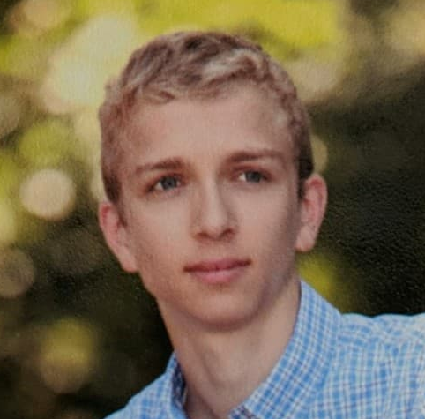
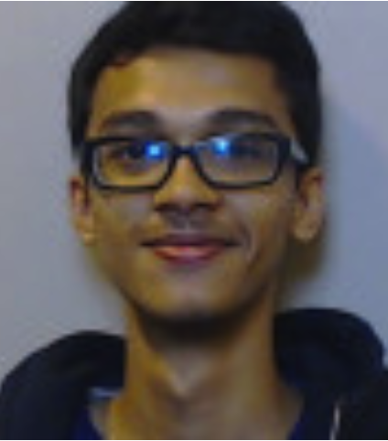

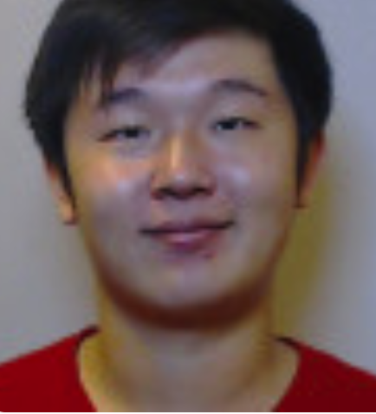

OUR TEAM
HAYWORTH ANDERSON
JACOB BRINK
ADVAIT
SCARIA
ETHAN
WALTERS
NATHAN WANG

Slide 3

OUR VISION
For Calvin faculty and students
Primarily student organizations
The Hunt: virtual and physical (more on this in the demo!)
Keepers: create destinies
Seekers: follow destinies

Slide 4

“Predestination combines technological ingenuity with an age-old game to deliver a fun, modern spin in this time of need for environmental care and social bonding in a socially distanced world, leaving nothing behind except ephemeral footprints.”

Slide 5
D E M O T I M E!
(a live UI Mockup)

Slide 6
D E M O T I M E!
(a live UI Mockup)
Status Report
Ability to delete hunts
Connect app to database
And a few more!

Slide 7
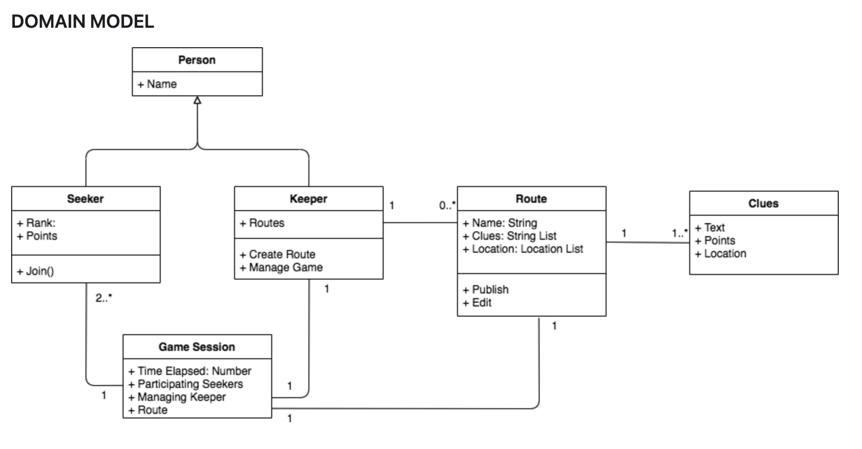
ANALYSIS & DESIGN

Slide 8
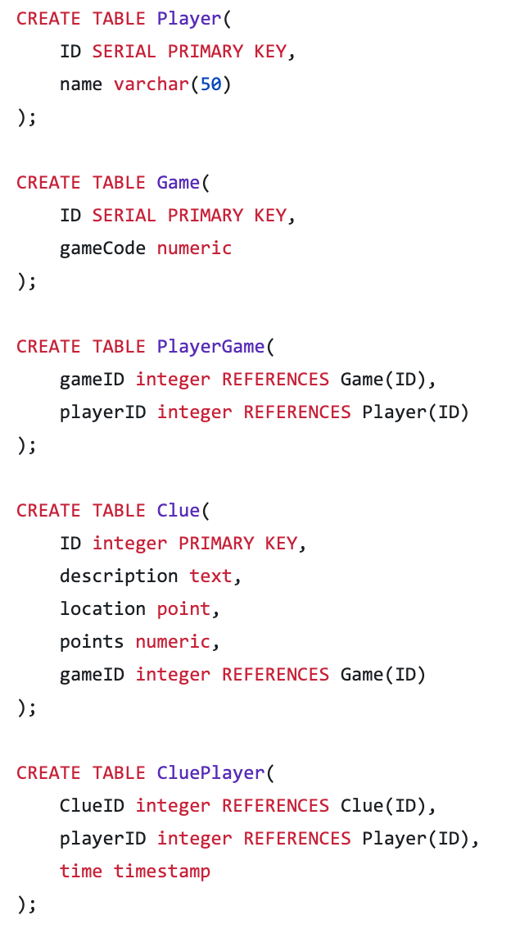
INFO SYS. DESIGN

Slide 9
Questions?

